Slide 1

FORKED ASSIGNMENT
How to fork and complete assignments.
Notes:
This power point lesson is specifically designed to be a course outline for the topic, and not exhaustive. The instructor should add their experience and knowledge to the bullet points presented here. These bullet points are key points, or linchpin points in the overall goal of understanding.

Slide 2
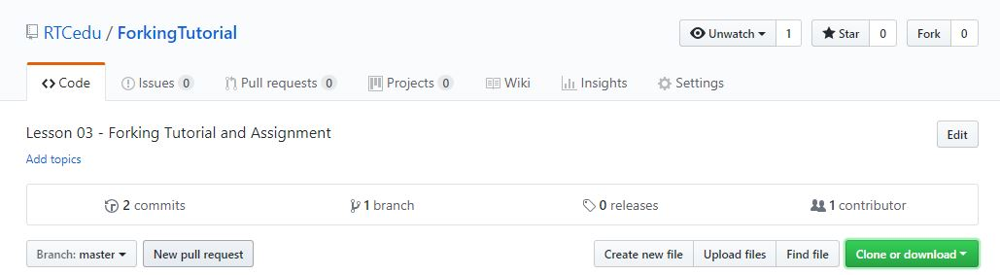
Assignments with Pre-existing Repository
Assignments with pre-existing repositories
Will be hosted at www.github.com/RTCedu
Link to repository provided in assignment on Canvas
The Fork button is in the upper right of the repository
Notes:
Take a moment to show the RTCedu organization page on GitHub.
Ask if anyone has questions on it.
Be sure to specific that it is also used by the CIT BAS, CS BAS, and may be used by the CNT AAS program.

Slide 3
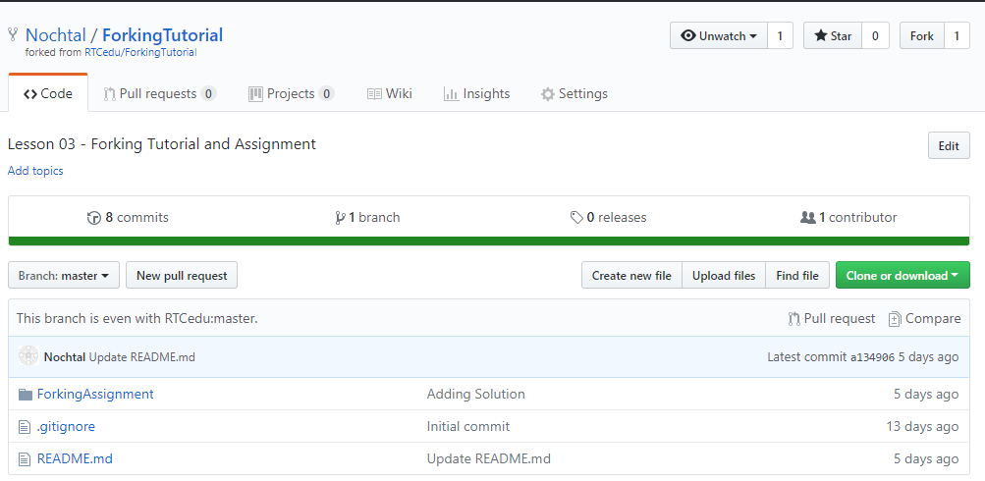
Your Forked Repository
Successful Fork: Forking will take a moment to copy the original repository to a new version under your account.

Slide 4
Clone to Local Repository
Same as before: Feel free to refer to Lesson 2’s slides for refresher.
Clone or Download
Copy Link
GitKraken
Clone Repo
Set local destination
Paste URL
Clone the repo!
Notes:
Idea: have students try to clone the repository to local first, give help when asked.

Slide 5
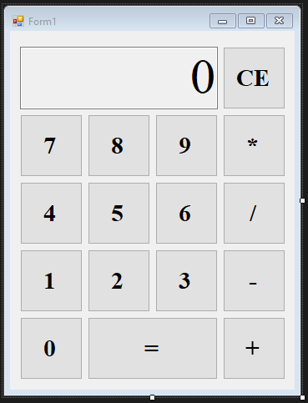
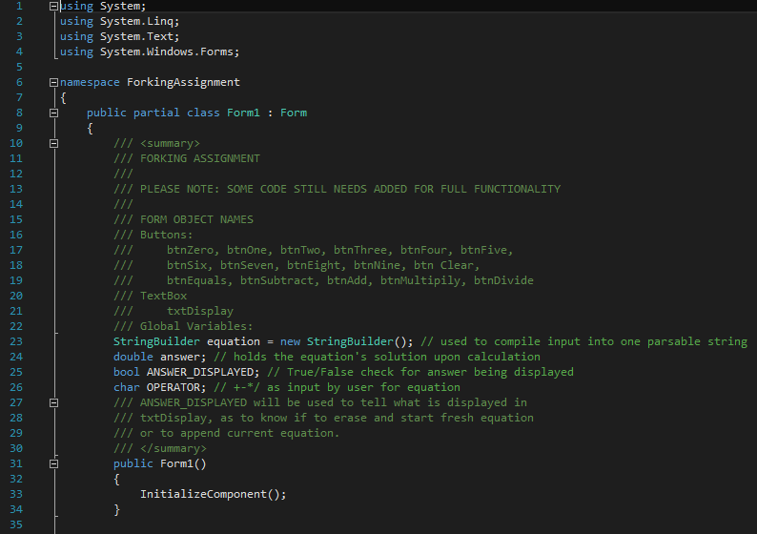
The Code
Form1.cs
The GUI is already designed, and all objects named.
Buttons are named as btnZero – btnNine, and btn[Function]
Solution Explorer → Form1.cs :: double click to open.
Right click Form1.cs in Solution explorer and select “view code”
Notes:
Be ready to open the project and show the students how to access the code and the Form design, as this is likely their first experience with Windows Forms applications.

Slide 6
Code Basics
Setup:
The code is mostly there. Only some lines have been removed.
Button Code
Dictates what the button does upon click.
private void btnZero_Click(object sender, EventArgs e)
When clicked, all code in the brackets will run, sequentially.
Methods
Accessibility return name(input)
The basic methods to make the code work are already present.
Notations are present to explain them.
Notes:
The importance here is forking the repository, making changes to commit and push, and then turning in the repository URL.
Don’t spend much time on explaining button click events, or the methods, give high level overview with the caveat that such things will be covered during the course.

Slide 7
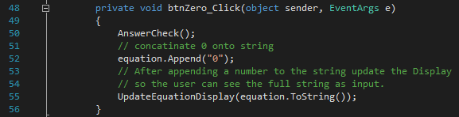
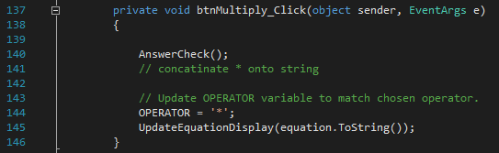
What to Add?
btnZero_Click on line 48 is complete.
The rest of the number buttons require a line of code to be added to properly function.
The buttons for multiply (line 137), divide (line 148), subtract (line 159), and Add (line 170) require two lines to be placed. Multiply has the second line to place already present as an example.
Line 180 and beyond are completed and include the buttons for Equals and Clear along with the methods used.
Notes:
Lines that require code to be inserted (line itself exists as a blank line)
63, 72, 81, 90, 99, 108, 117, 125, 133, 142, 153, 155, 164, 166, 174, 176.
Again: importance is in utilizing the source control techniques, GitKraken, and committing, pushing, and turning in repositories.
Leave this slide up while students work on the code, walk the classroom to be available to answer questions, encourage students to converse, help each other, and foster good working relations within the cohort.

Slide 8
Commit, Push, and Turn In
Commit: GitKraken
Click the top option (// WIP) to see updates that are not yet committed.
Stage All Changes
Add Summary and Description
Commit.
Push
Click Push to update the master origin repository on your GitHub
Turn In
On Canvas, navigate to assignment
Click submit, paste URL to your forked repository
Turn in.
Notes:
Image examples of this process found in Lesson 2. Please refer to the associated PowerPoint for lesson 2.
Be sure to entertain questions: at this stage, let a student as the question, then see if any other students are able to answer. If none can, then provide the answer to the students question. It is important for the students to use the knowledge of using Source Control as much as possible, even if it is answering questions about Source Control with their cohort.

